Slide 1
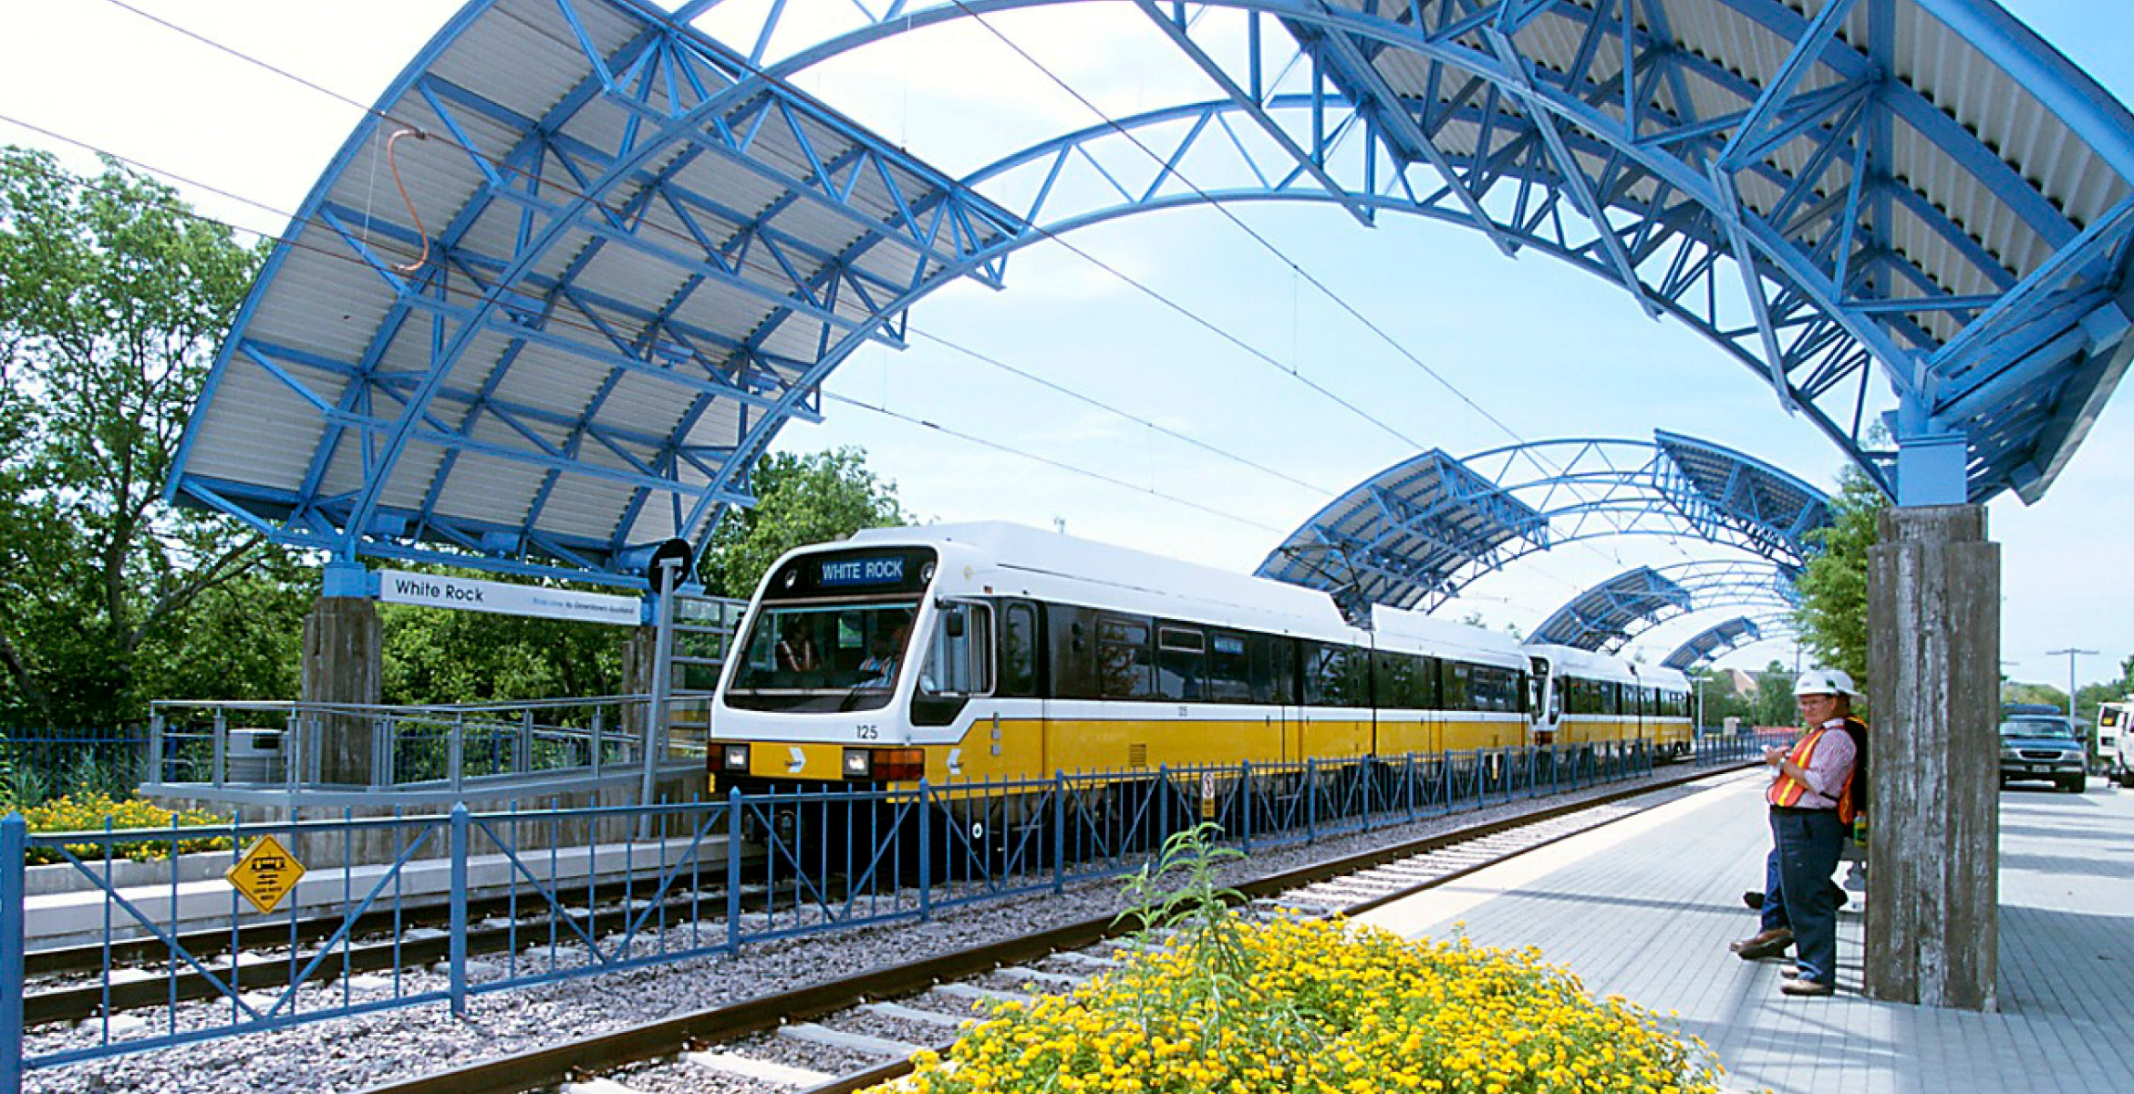
Railway Reservation System
presentation

Slide 2
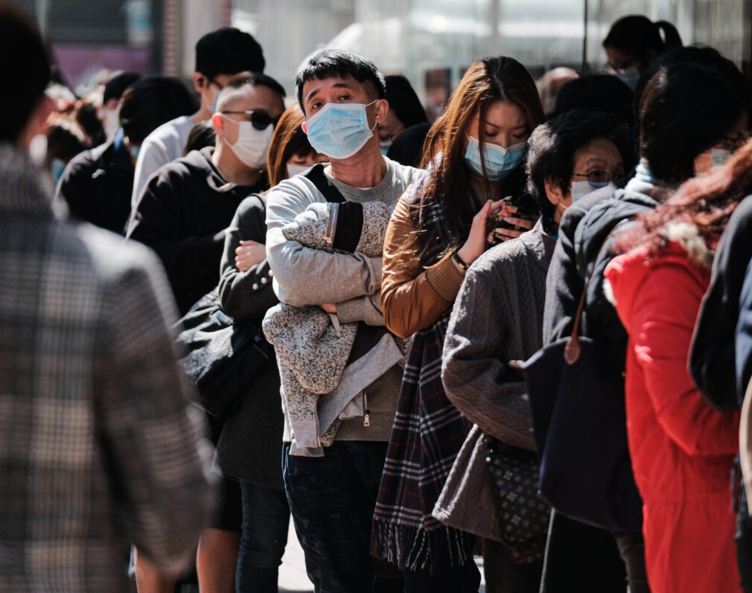
Problem definition
In only a few weeks, COVID-19 has profoundly changed our lives, the epidemic is increasing people’s anxiety and worry, affecting their social relations, their trust in other people and in institutions, their personal security and sense of belonging.

Slide 3

Introduced solution
People tend to use Internet applications in abundance to limit personal interaction between humans to reduce standing in crowds and the epidemic.

Slide 4
Railway Ticket Reservation System is a ticketing system which provides facility to the railway administration of booking the tickets for passengers digitally.
the booking process has become easier, and within the reach of travelers
the user can select the governorate from which he wants to travel and to which he wants to go , and the available trains will appear to him, where they can inquire about vacant seats on air-conditioned trains, and determine the number of tickets To be booked
The travel date and train time will be specified
The users will need to enter their visa card.
The ticket will appear automatically specifying dates and seats and all the details about the trip.
Scope

Slide 5
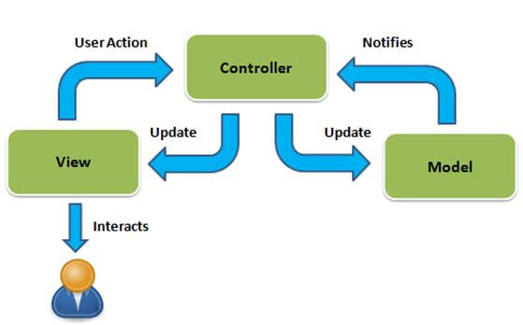
MVC

Slide 6
Functional Requirements
The user shall register to the system by entering his information (Username, E-mail, Telephone).
The user shall login to system with username and password, the login process will not complete until the verify function is applied.
The System should generate a unique identification No. for each passenger that is to differentiate between passengers with similar data.
The user shall select the departure station, the destination, And the travel date including their arrival and departure time.

Slide 7
Functional Requirements
In case there are available seats, The user shall select number of seats, coaches' class and train type.
Users can pay tickets fees electronically using Visa or Master Cards.
Users can edit or cancel the ticket reservation and the fare will be refunded in case of cancellation.
Admin can add, remove and modify trains information.
Admin can add, remove user information.
Admin can get passenger list.

Slide 8
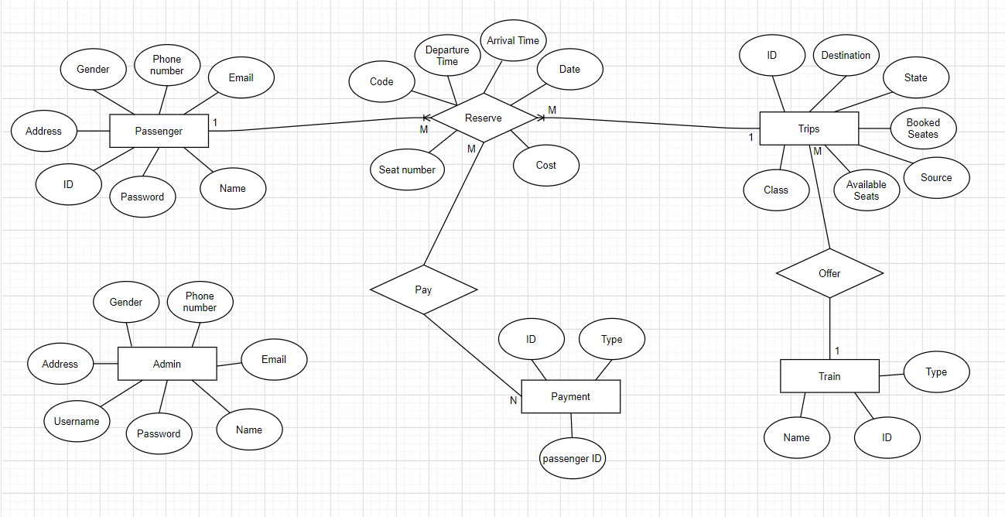
ERD

Slide 9
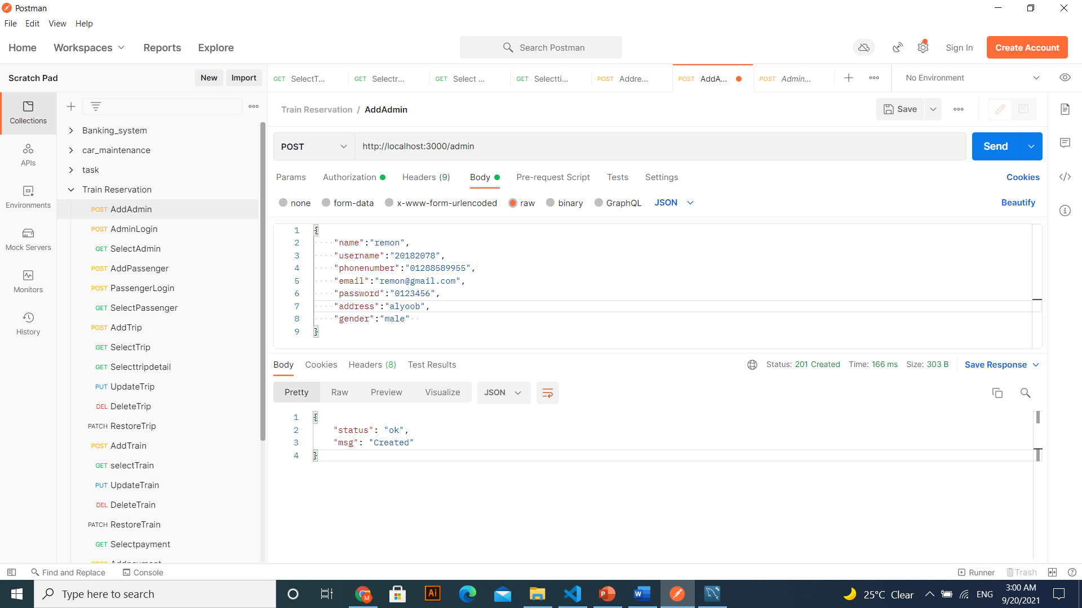
Demo

Slide 10
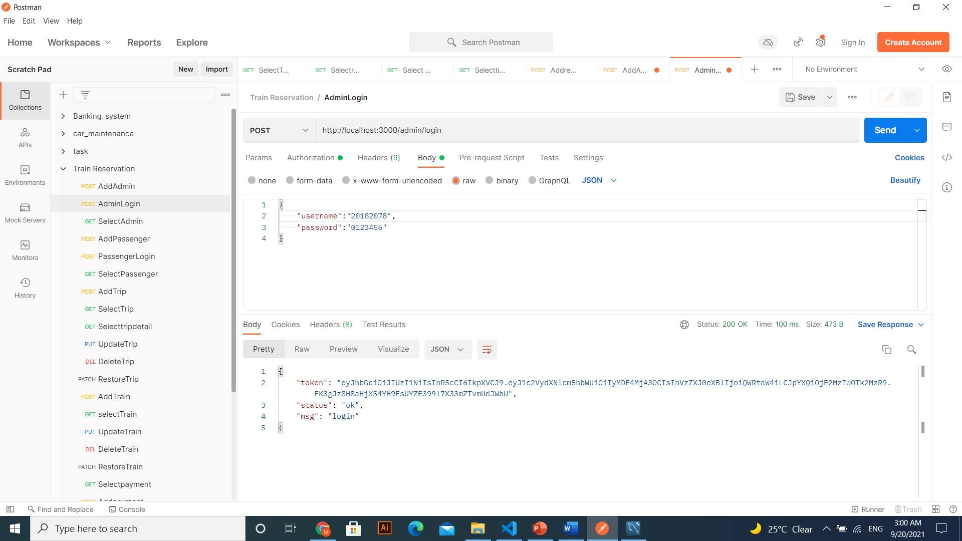

Slide 11
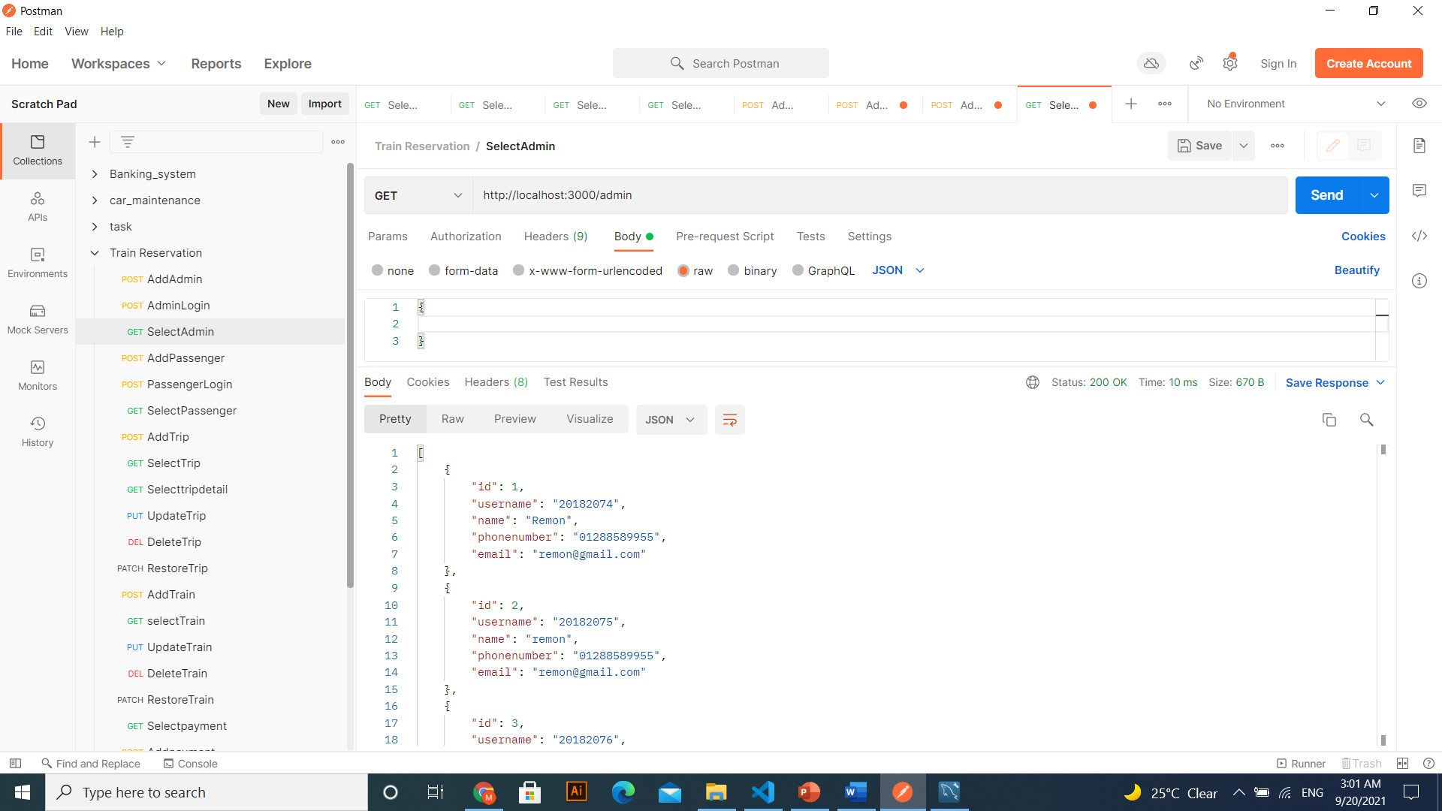

Slide 12
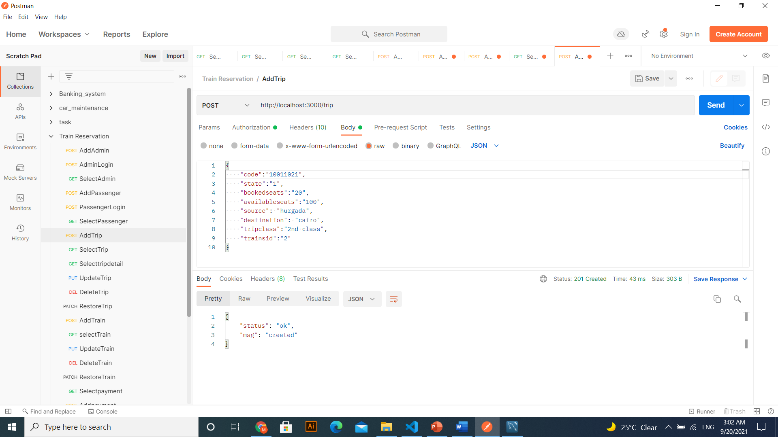

Slide 13
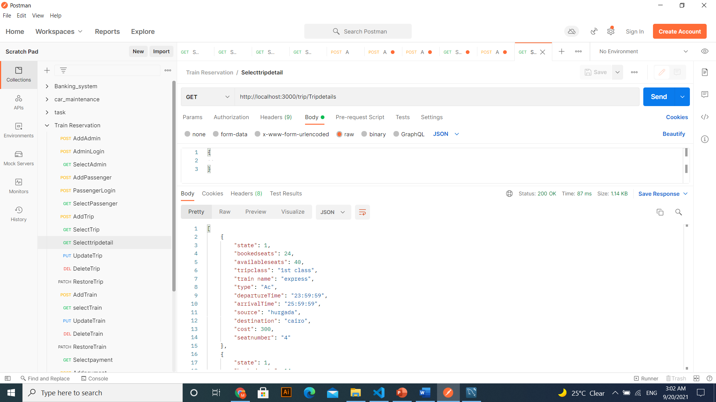

Slide 14


Slide 15


Slide 16
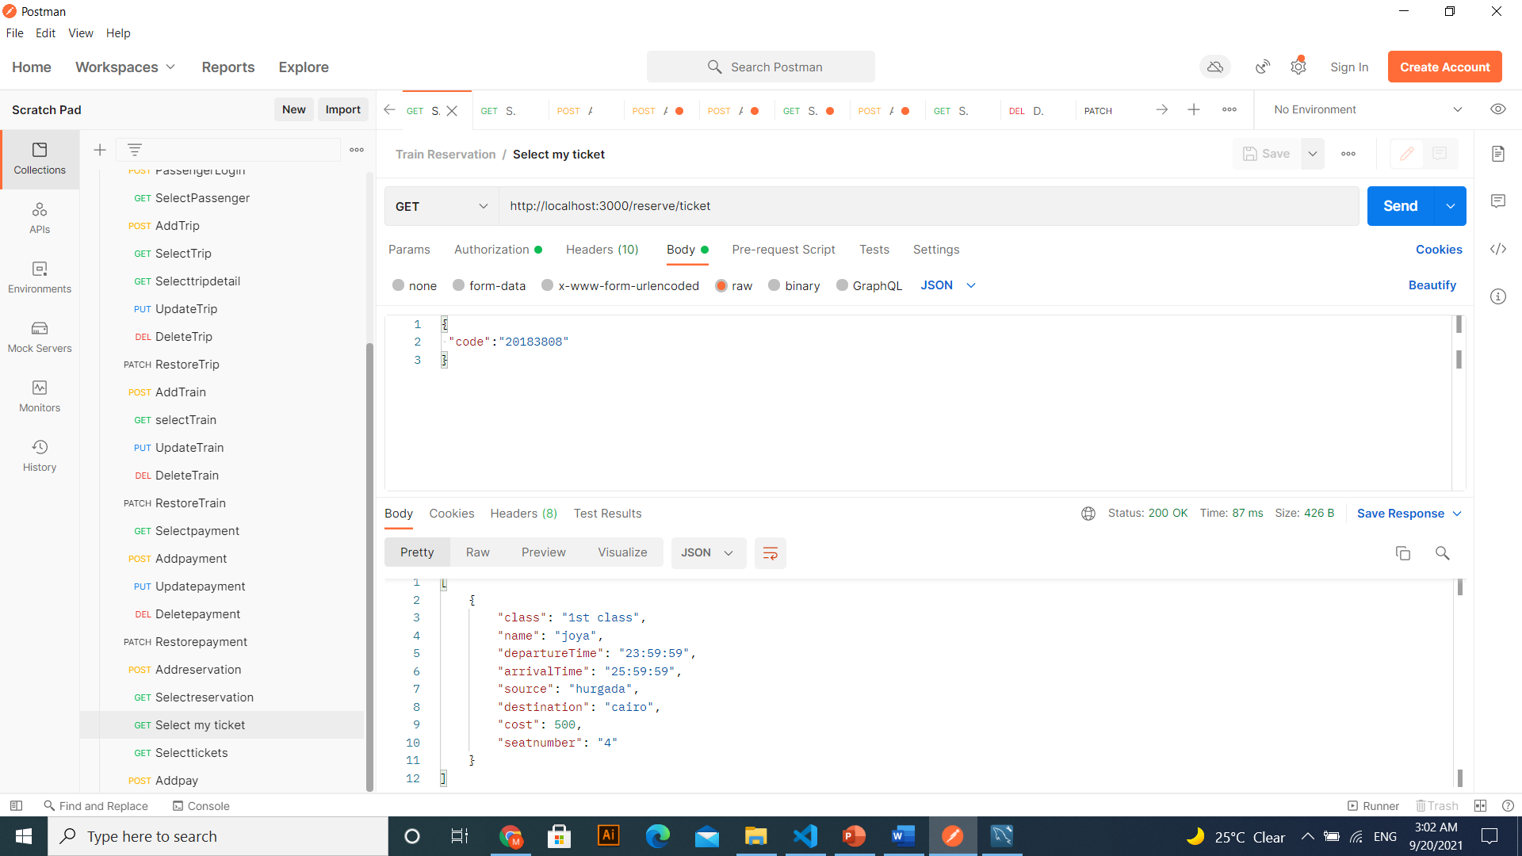

Slide 17


Slide 18

Thank You!

